Slide 1

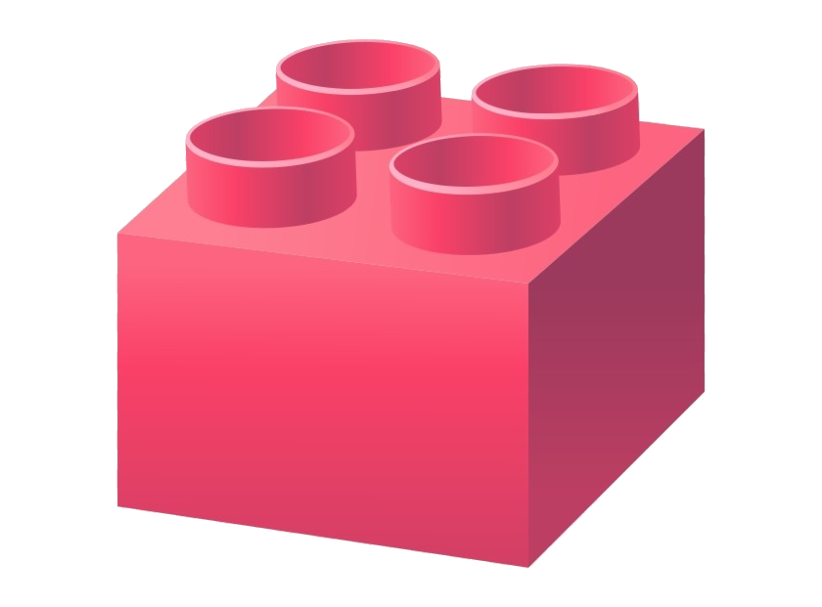

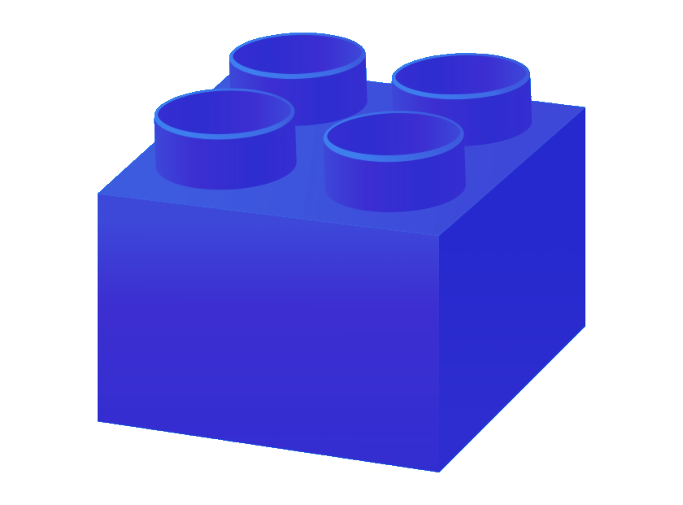

Embedded Communications 2/3
Embedded
Systems II
I2C
SPI
L13
Lecturer Best :)
Electrical Engineering
University of Cape Town

Slide 2
Outline of Lecture
Getting into the SPI and I2C serial protocols
Plan for 03 Sept:
Training for I2C
Acknowledgement: these slides adapted from ESII 2021 slides by J. Wyngaard.

Slide 3
ES Communications Training Plan
Comms 1:
Intro: Serial vs Parallal, Synch/Asynch
Comms 2:
I2C & SPI
PWMs & Peripherals
Comms 3:
Timers
RS232 & RS485
Brieﬂy, some other interface protocols
{Brief Introduction to Wireless Communications – if time permits}

Slide 4
The I2C Protocol
I2C

Slide 5
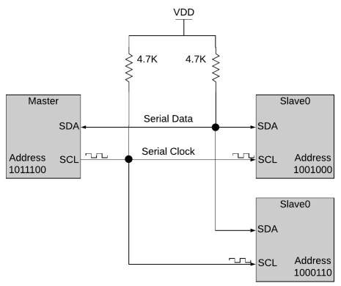
I2C Protocol Overview
I2C = Inter-Integrated Circuit, aka “eye squared” (I2C)
A communication protocol Invented by Philips Semiconductor in 1989
Half duplex (both ends can send but not simultaneously)
Serial (bits sent sequentially one at a time)
Synchronous (uses shared clock)
Simple, robust, low cost
Easy to use when you need communication between a chain of devices and a microprocessor / microcontroller
2 wires:
SDA: Serial Data Line
SCL: Serial Clock Line
SDA: state changes when SCL is low

Slide 6
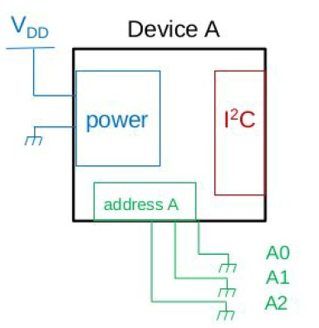
I2C Protocol Overview
Supports multiple master and multiple slaves
Widely used for short distance on PCB / nearby oﬀ-board communications (Eg: RTC, Temp sensors, ADC, EEPROM...)
Board layout is simple
Many libraries in many languages are readily available
Veriﬁcation of every byte is built in:
An acknowledge (ACK) signal is built into the protocol after every data word
Speeds:
Standard mode: 100 kbit/s
Fast mode: 400 kbit/s
High speed: 3.4 Mbit/s
Often some bits of the address will be set in hardware while others can be deﬁned by the PCB designer.
e.g.: A2, A1, A0 are held to ground in the PCB = '000’
A6, A5, A4, A3 are set in the IC device

Slide 7
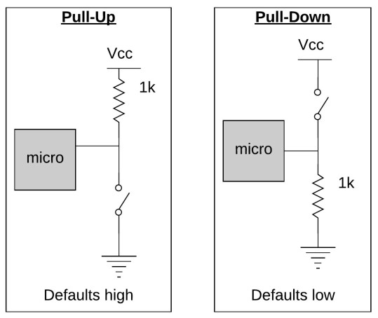
Recap: Integrated Circuit Input/Outputs
Digital logic can be High / Low / Floating (undeﬁned)
Pull up/down resistors remove the chance of ﬂoating/undeﬁned values by creating a default so the state of a pin is always known
Some ICs include these pull up/down resistors internally (check the datasheet)
Resistor value depends on pin impedance and leakage current

Slide 8
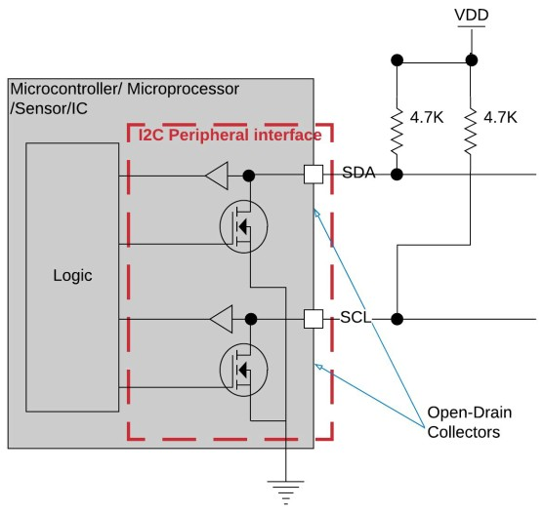
I2C Hardware
I2C interface pins will have an open drain collector on both the clock and data pins.
A 4.7k is a standard recommendation for pull-up resistors to use.
Bus signals always default to logic high and so must be actively pulled low for operation
If a devices dies the lines will return high and be available for other devices to continue functioning
If needed a slave can hold the clk low to reduce frequency
Diﬀerent VCCs on the same lines can exist (provided other devices can tolerate higher V)

Slide 9
I2C Protocol
Sequence of actions performed when communicating via I2C:
Idle state: SDA & SCL Signals HIGH //Default state for SCL and SDA is HIGH
Start command: SDA transitions from HIGH to LOW while SCL is HIGH. //Pulling low is an active action
Stop command: SDA transitions from LOW to HIGH while SCL is high //Release control of line
Read: Transmitter leaves SDA to stay HIGH (logic 1) after an address
Write: Transmitter pulls SDA LOW (logic 0) after an address
Acknowledge (ACK): Receiver actively pulls SDA LOW
Not Acknowledge (NACK): Receiver doesn’t pull SDA LOW, defaults to HIGH

Slide 10
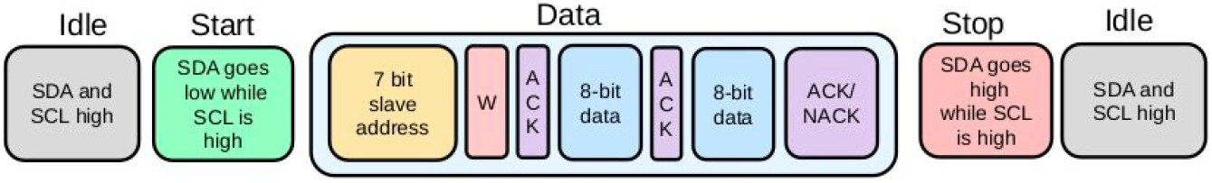
I2C Protocol: Master writes to Slave
Master writes to Slave:
Both lines idle (HIGH)
Master transmits Start: SDA pulled LOW while SCL is high by master
Master transmits 7-bit Slave address to indicated which slave should listen to the data arriving
Master transmits Write bit: SDA pulled LOW for 1 bit by master or a read bit SDA pulled LOW for 1 bit
Receiving Slave (who was addressed) transmits ACK (acknowledge) bit: SDA is actively pulled LOW for 1 bit by the addressed slave, all other slaves leave line high. If address was invalid line is left high by all = NACK (not acknowledge)
Master transmits 8-bits of data, this is usually the address
Receiving Slave transmits ACK: SDA pulled LOW to acknowledge transmission
Master transmits next 8-bits of data
Master transmits Stop command to indicate end of communication with that slave (lets SDA stay high while SCL HIGH)

Slide 11
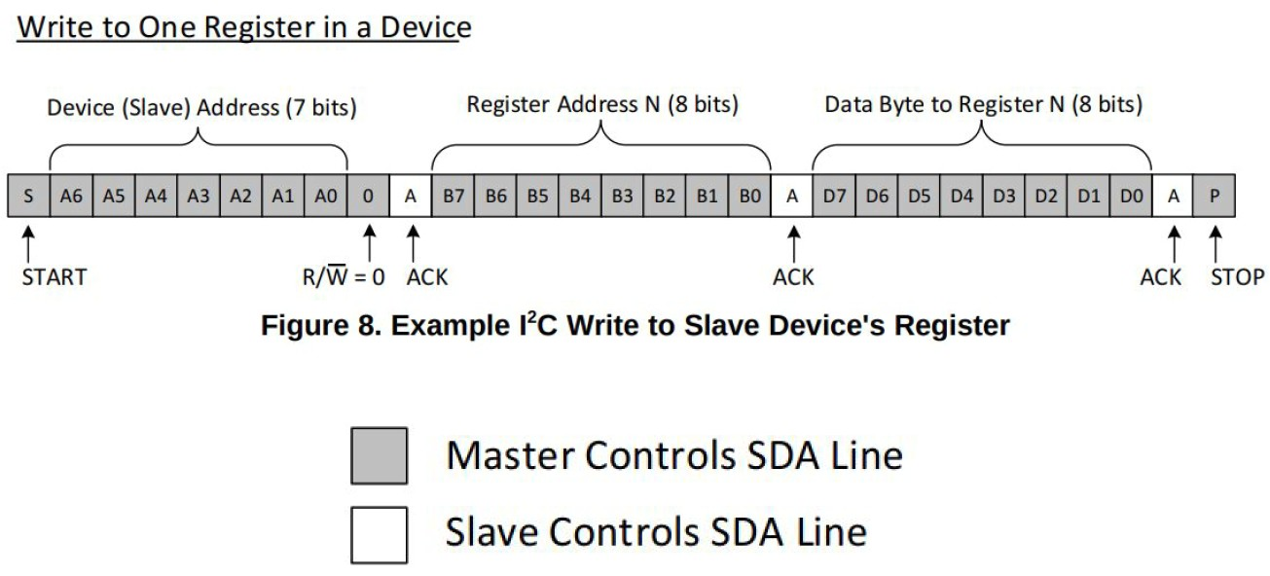
I2C Protocol: Master writes to Slave
Illustration showing sequence of bits sent on the I2C SDA line, which bits are driven by the master (gray block) and which are driven by slave (white blocks).

Slide 12
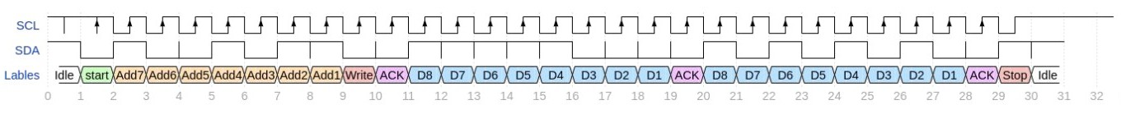
I2C Protocol: Master writes to Slave
Illustration of SCL (clock) and SDA (data) lines
SCL positive edge indicates SDA is ready to be read

Slide 13
I2C Arbitration and clock stretching
Arbitration =
With multiple masters on a bus, each monitors for idle (both lines high) and only uses the bus when it is free.
If two masters attempt to use the bus simultaneously, the ﬁrst to pull SDA low while trying to transmit a '0' will 'win' and the other will back oﬀ.
Clock stretching =
Any device can hold SCL low, if a device wishes to slow the clock it can do so by simply holding SCL low longer than is otherwise anticipated.

Slide 14
I2C in context
Key Disadvantage:
Frame overhead (address and ACK bits) costs time
Hardware complexity increases as master/slave devices are added
Key Advantages:
Only 2 wires
Ack facilitates reliable operation
Easy support for multiple Vdd levels (assuming all ICs can tolerate highest level)

